Slide 1

NARULA INSTITUTE OF TECHNOLOGY
SUBMITTED BY-RUDRASISH BAGCHI(65), RABINDU CHOWDHURY(66),SUBHAM MUKHERJEE(67),VINAY SHAW(68), SUVOJIT ACHARYYA(69)
‘

Slide 2
NATURE OF A SYSTEM OF LINEAR EQUATION

Slide 3
INTRODUCTON
In Engineering Mathematics, solution of simultaneous equations is very important. In this chapter we shall study the system of linear equations with emphasis on their solution by means of determinants.

Slide 4

DEFINITION OF A MATRIX
A matrix is a rectangular array of numbers arranged in rows and columns.If m-n number are arranged in a rectangular array of m rows and n columns, it is called a matrix of order m by n(written as m x n) or a matrix of dimension m x n or a matrix of type m x . A matrix of order m x n is usually written as follows :
$$\left(\begin{matrix}a_{11} & a_{12} & a_{13} … \\ a_{21} & a_{22} & a_{23} … \\ \begin{matrix}a_{31} \\ {\begin{aligned}⋯ \\ a\end{aligned}}_{m1}\end{matrix} & \begin{matrix}a_{32} \\ {\begin{aligned}⋯ \\ a\end{aligned}}_{m2}\end{matrix} & \begin{matrix}a_{33 …} \\ {\begin{aligned}… \\ a\end{aligned}}_{m3 …}\end{matrix}\end{matrix} \begin{matrix}a_{1n} \\ a_{2n} \\ \begin{matrix}a_{3n} \\ {\begin{aligned}… \\ a\end{aligned}}_{mn}\end{matrix}\end{matrix}\right)$$
The number $a_{11} , a_{12}$ etc. Constituting a matrix are called the elements or entries of the matrix

Slide 5
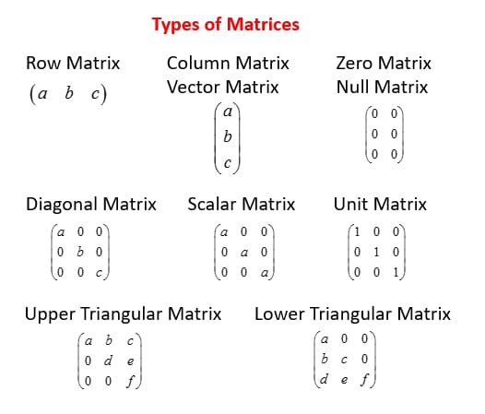
TYPE OF A MATRIX

Slide 6



COEFFICENT Matrix :
$a_{11}x_{1}$ + $a_{12}x_{2}$ + ………+$a_{1n}x_{n}$ = $b_{1}$
$a_{21}x_{1}+ a_{22}x_{2}+$………+$a_{2n}x_{n}$ = $b_{2}$
. . . .
. . . .
$a_{m 1}x_{1}+ a_{m2}x_{2}$+………+$a_{mn}x_{n}$ = $b_{m}$
Where x₁ , x₂,……, x_{n} are the unknown and number a₁₁ , a₁₂,…….a_{mn} are the coefficients of the system. The coefficient matrix is m x n order matrix with elements.
$$\left(\begin{matrix}a_{11} & a_{12} … & a_{1n} \\ a_{21} & a_{22 }… & a_{1n} \\ a_{m1} & a_{m2 a …} & a_{mn}\end{matrix}\right)$$
Echelon matrix :
$\left(\begin{matrix}1 & 0 & 0 \\ 0 & 1 & 0 \\ 0 & 0 & 1\end{matrix}\right)$ , $\left(\begin{matrix}0 & 2 & 1 \\ 0 & 0 & 1 \\ 0 & 0 & 0\end{matrix}\right)$ , $\left(\begin{matrix}1 & 0 & 2 \\ 0 & 1 & 0 \\ 0 & 0 & 1\end{matrix}\right)$

Slide 7
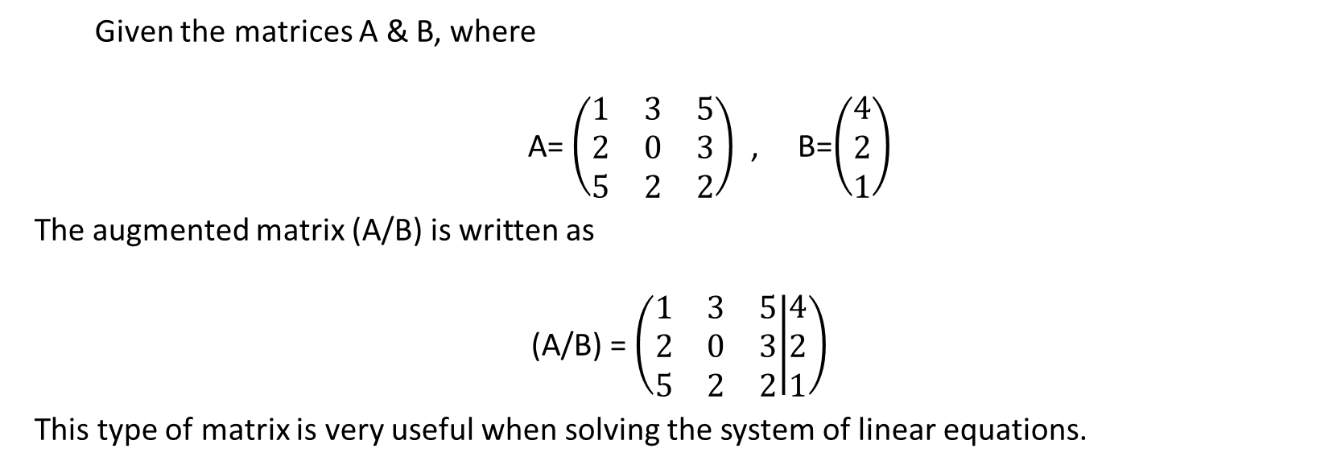
AUGMENTED MATRIX
Given the matrices A & B, where
A= $\left(\begin{matrix}1 & 3 & 5 \\ 2 & 0 & 3 \\ 5 & 2 & 2\end{matrix}\right)$ , B=$\left(\begin{matrix}4 \\ 2 \\ 1\end{matrix}\right)$
The augmented matrix (A/B) is written as
(A/B) = $\left(\begin{matrix}1 & 3 & 5 \\ 2 & 0 & 3 \\ 5 & 2 & 2\end{matrix} | \begin{matrix}4 \\ 2 \\ 1\end{matrix}\right)$
This type of matrix is very useful when solving the system of linear equations.

Slide 8
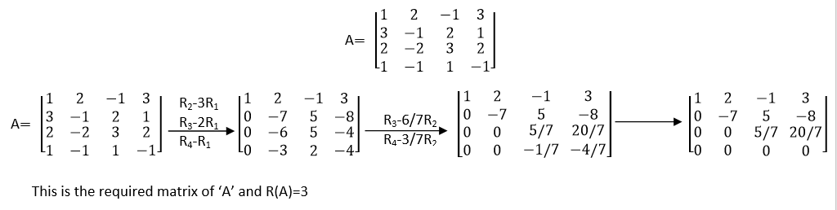
Rank of Matrix:- ‘A’ be a matrix, a natural number r is said to be rank of ‘A’ denoted by R(A) if there is at least one are sub rth order non-singular square submatrix of ‘A’ every Square sub matrix of ‘A’ of order greater than r is singular
Example:- Find the rank of the given matrix
RANK OF MATRIX

Slide 9
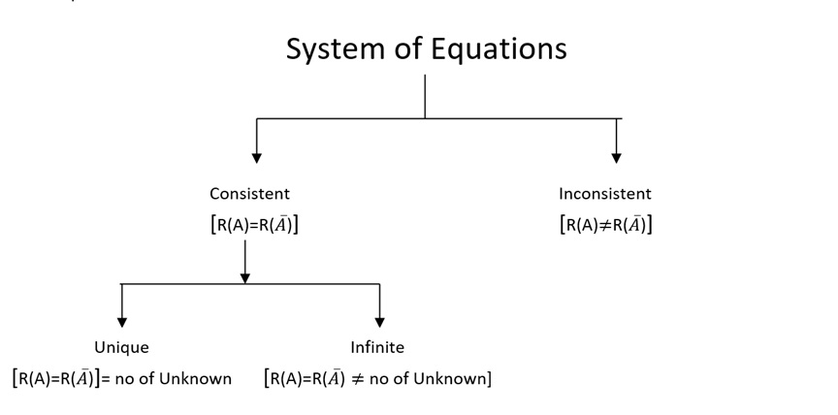
System of an Equations :
A linear equation in a unknowns x₁, x₂,….....x_{n} is an equation of from a₁x₁+a₂x₂+………+ a_{n}x_{n}=b ………(1)
In the above equation, if b=0 then it is called a homogeneous linear equation. In contrast, (I) is called a non homogeneous linear equation.
Consider a set of m non-homogeneous linear equations in n unknowns:
A₁₁x₁+a₁₂x₂+……….+a_{1n}x_{n}=b₁
A₂₁x₁+a₂₂x₂+……….+a_{2n}x_{n}=b₂
… …………… …………….. ………
… …………… …………….. ………
A_{m1}x₁+a_{m2}x₂+……….+a_{mn}x_{n}=b_{m}

Slide 10
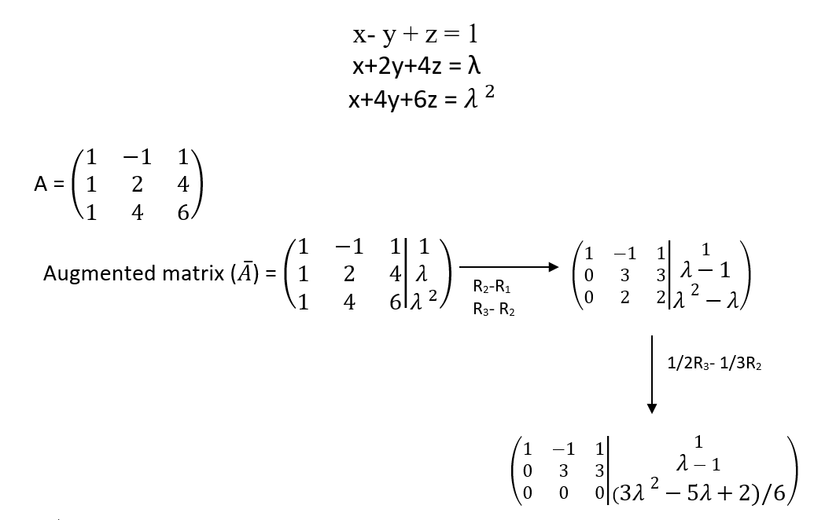
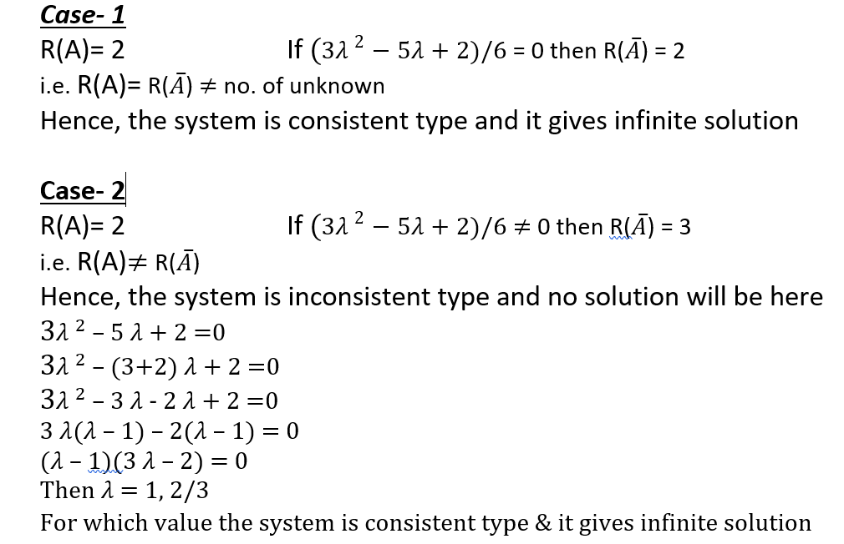
For what real value of a following system of equations are
Consistent ? Solve in each consistent case.
Ans:-

Slide 11
CONCLUSION
We could not have done this project without the help of our mathematics professor Avishek Chakraborty Sir who had provided us with various information about the topic which is essential regarding the completion of this project.
The topic “Nature of solution of a system of Linear Equation”,has given us the complete idea regarding any equation which falls under the category either consistency or inconsistency and also tells us about the nature of solution it can give that is unique solution,infinite solution and no solution.

Slide 12

CREATED BY- SUVOJIT ACHARYYA

